Slide 1
Maximum Likelihood Estimation

Slide 2
The Method of Maximum Likelihood
Suppose that the data x₁, … , x_{n} has joint density function
f(x₁, … , x_{n} ; θ₁, … , θ_{p})
where θ = (θ₁, … , θ_{p}) are unknown parameters assumed to lie in Ω (a subset of p-dimensional space).
We want to estimate the parametersθ₁, … , θ_{p}

Slide 3
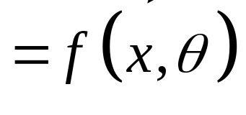
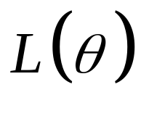
Definition: The Likelihood function
Suppose that the data x₁, … , x_{n} has joint density function
f(x₁, … , x_{n} ; θ₁, … , θ_{p})
Then given the data the Likelihood function is defined to be
= L(θ₁, … , θ_{p})
= f(x₁, … , x_{n} ; θ₁, … , θ_{p})
Note: the domain of L(θ₁, … , θ_{p}) is the set Ω.

Slide 4
Definition: Maximum Likelihood Estimators
Suppose that the data x₁, … , x_{n} has joint density function
f(x₁, … , x_{n} ; θ₁, … , θ_{p})
Then the Likelihood function is defined to be
= L(θ₁, … , θ_{p})
= f(x₁, … , x_{n} ; θ₁, … , θ_{p})
the Maximum Likelihood estimators of the parameters θ₁, … , θ_{p} are the values that maximize
= L(θ₁, … , θ_{p})

Slide 5
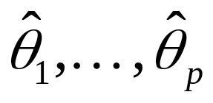
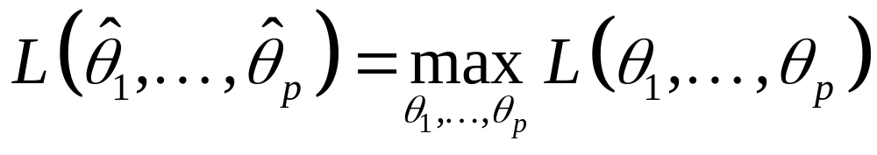
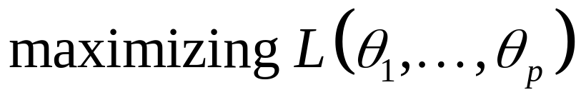
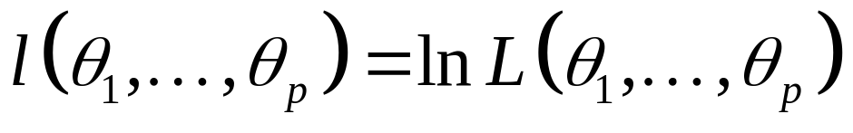
the Maximum Likelihood estimators of the parameters θ₁, … , θ_{p} are the values
Such that
Note:
is equivalent to maximizing
the log-likelihood function

Slide 6
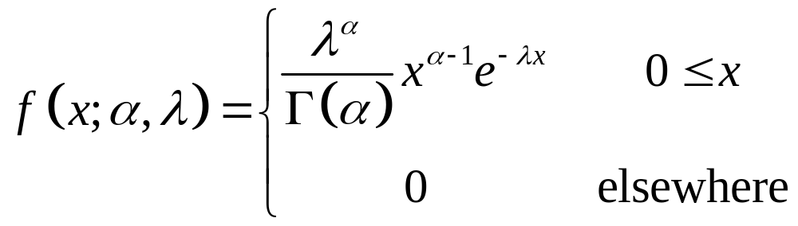
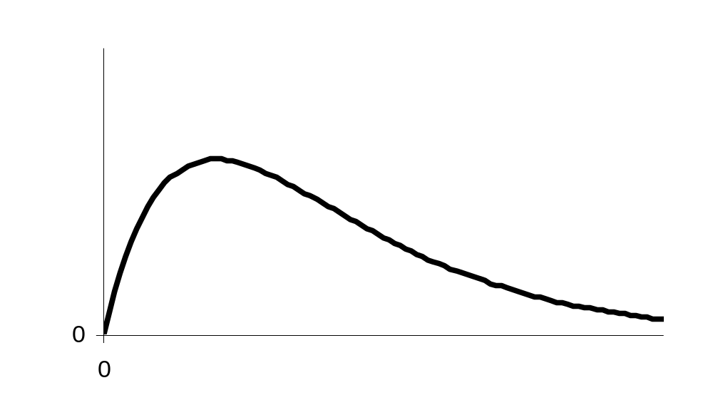
Example
Let x₁, … , x_{n} denote a sample from the Gamma distribution with parameters α and λ.

Slide 7
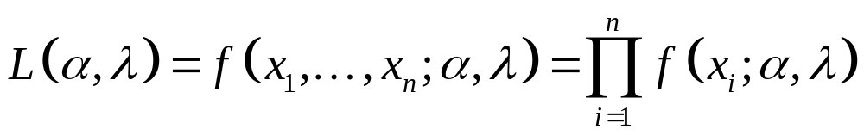
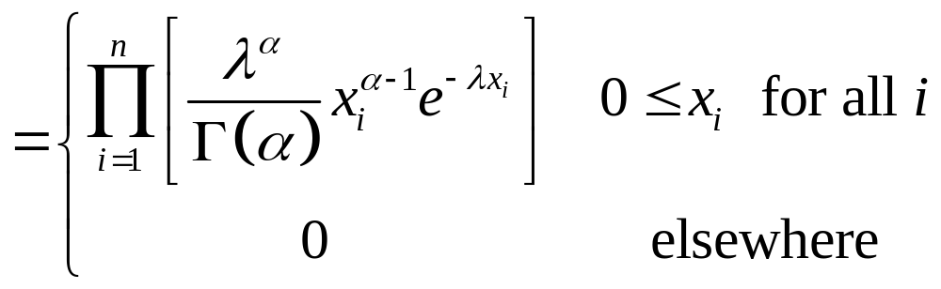
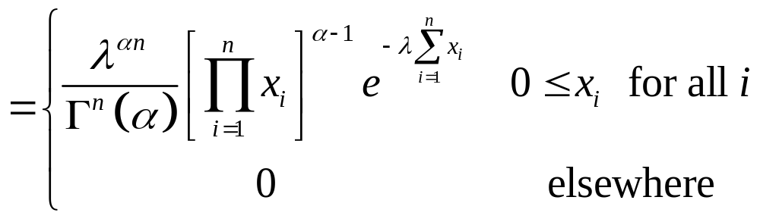
The joint density of x₁, … , x_{n} is given by:

Slide 8
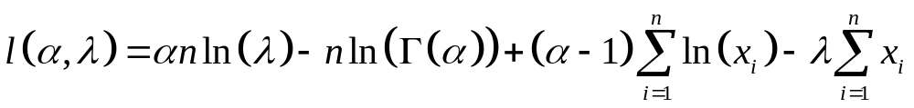
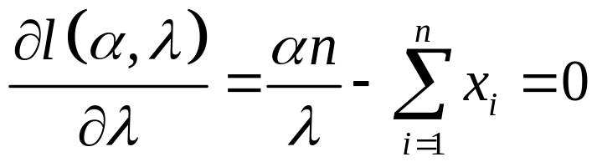
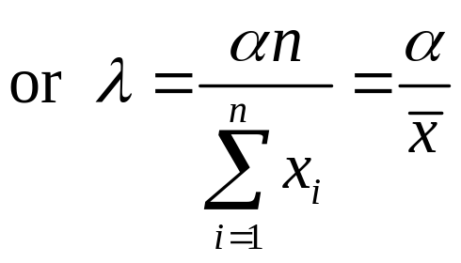
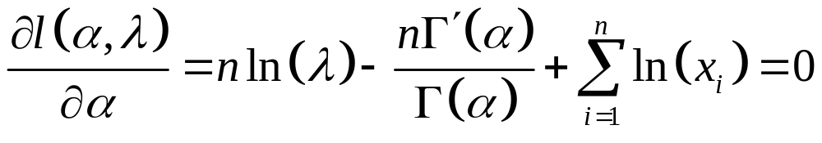
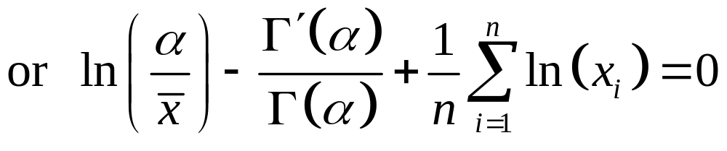
The log-likelihood function is given by:
Differentiating we get:

Slide 9
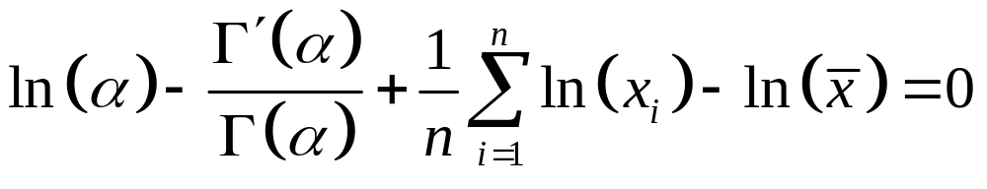
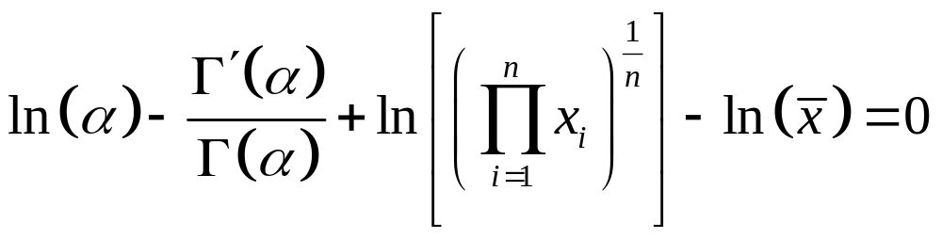
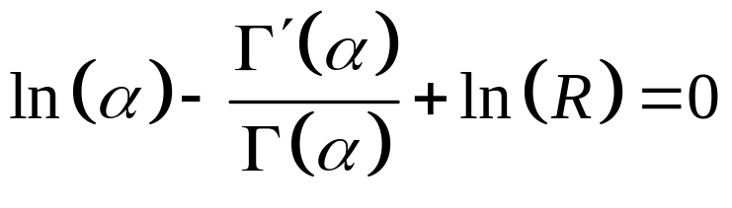
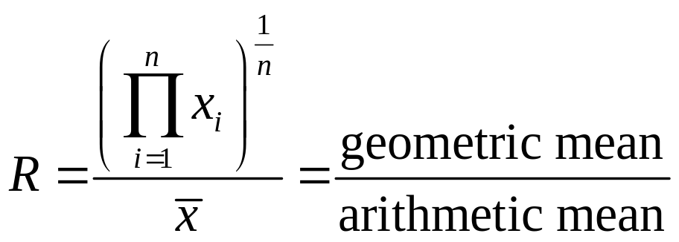
thus
or
and
where

Slide 10
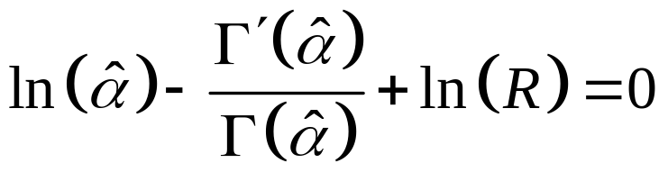
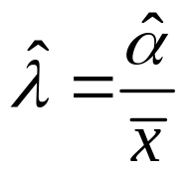
Hence to compute the maximum likelihood estimates of α and λ:
We compute
Solve the equation for the MLE of α.
Then the maximum likelihood estimate of λ is

Slide 11
Maximum Likelihood Estimation
Multivariate Normal distribution

Slide 12
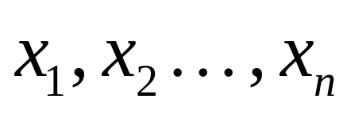


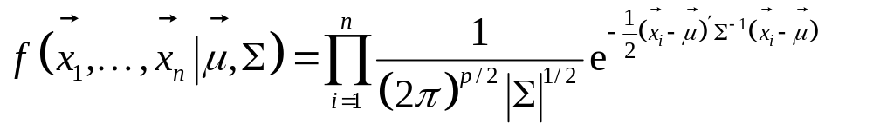
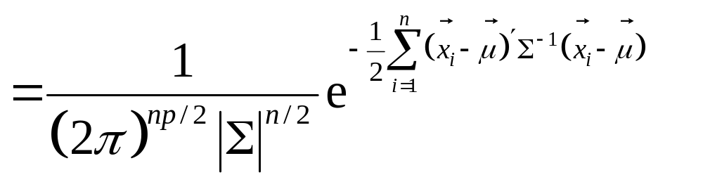
Let
denote a sample (independent)
from the p-variate normal distribution
with mean vector
and covariance matrix
Then the joint density function of
is:

Slide 13
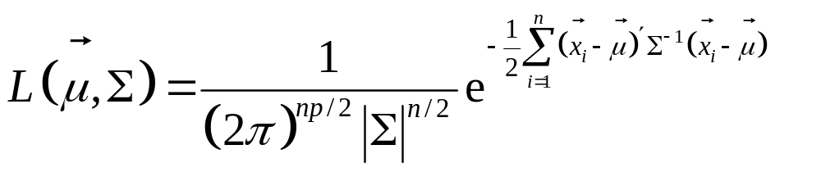
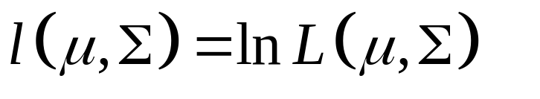
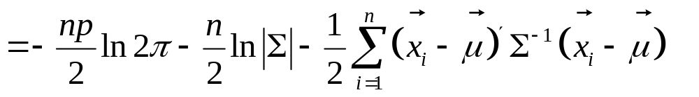
Hence the Likelihood function is:
And the Log-likelihood function is:

Slide 14
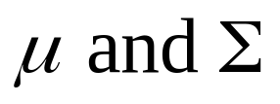
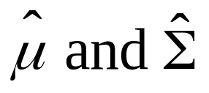
To find the Maximum Likelihood estimators of
we need to find
to maximize
or equivalently maximize

Slide 15
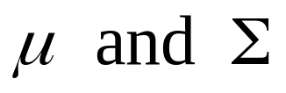
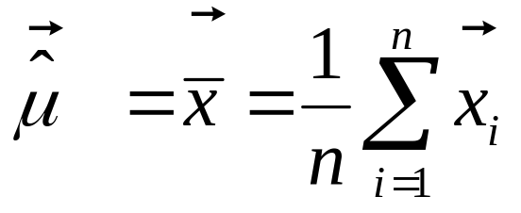
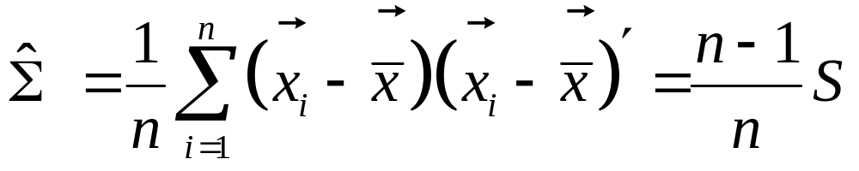
Solution
It can be shown that the Maximum Likelihood estimators of
are
and

Slide 16
Sampling distribution of the MLE’s

Slide 17
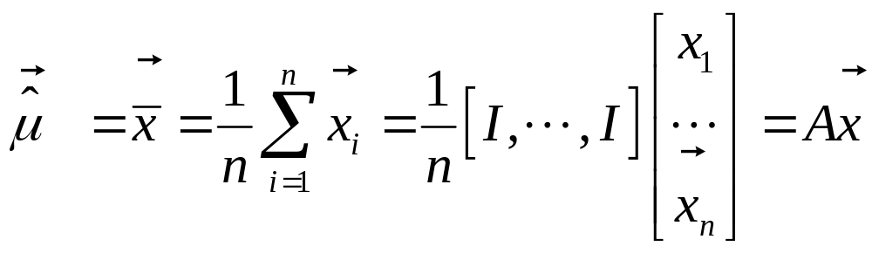
Note
The joint density function of
is:

Slide 18
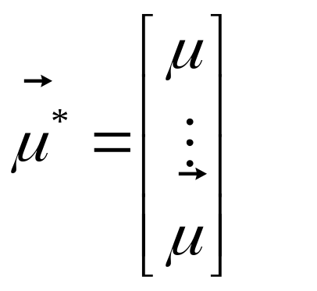
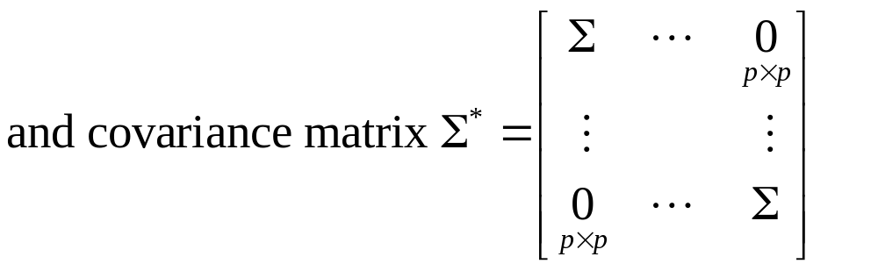
This distribution is np-variate normal with mean vector

Slide 19
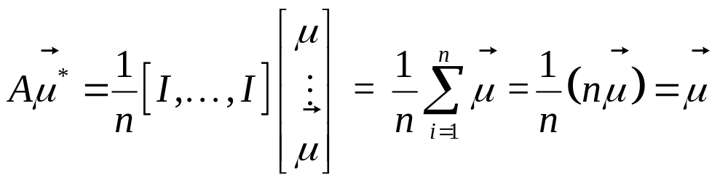
Thus the distribution of
is p-variate normal with mean vector

Slide 20
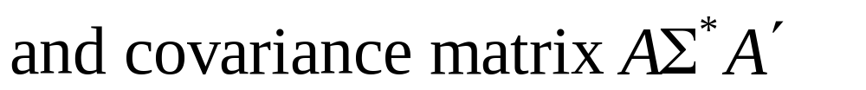
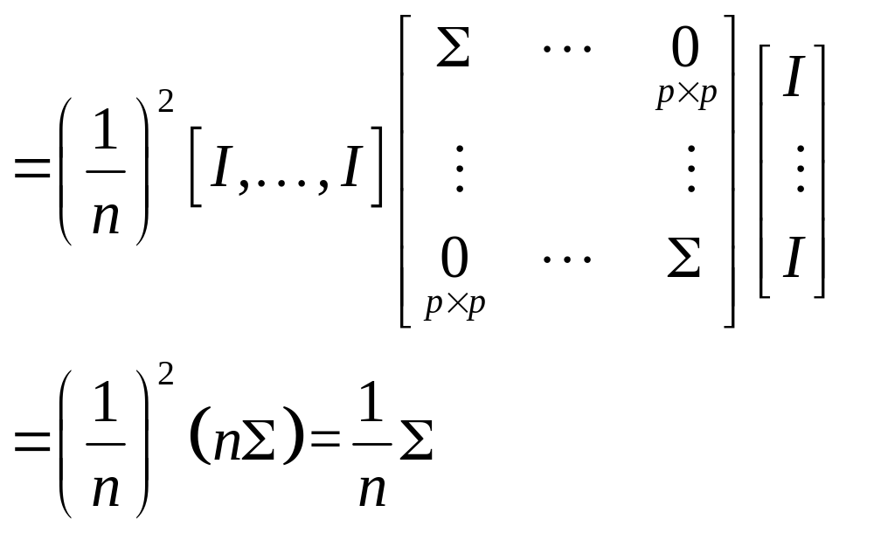

Slide 21
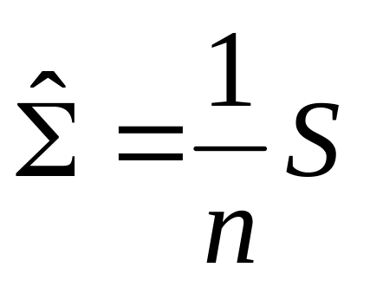
The sampling distribution of the sample covariance matrix S and

Slide 22
The Wishart distribution
A multivariate generalization of the χ² distribution

Slide 23
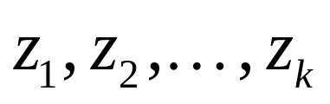
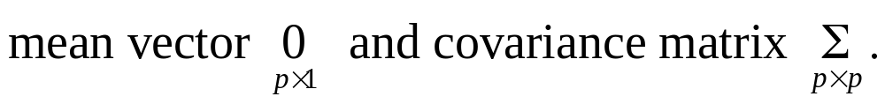
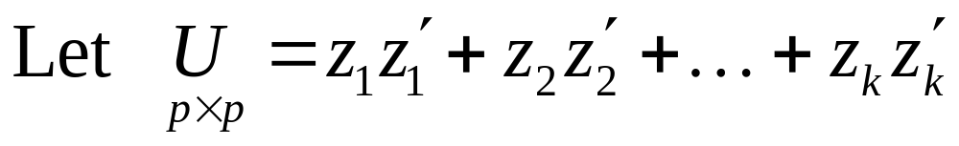
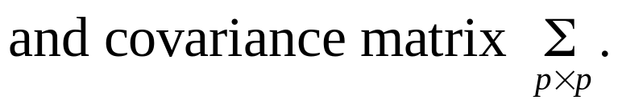
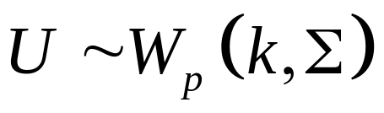
Definition: the p-variate Wishart distribution
Let
be k independent random p-vectors
Each having a p-variate normal distribution with
Then U is said to have the p-variate Wishart distribution with k degrees of freedom

Slide 24
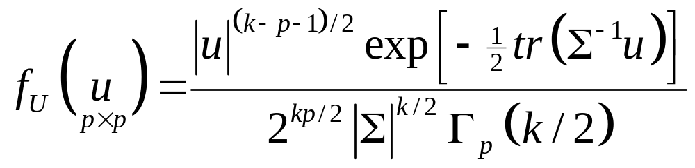
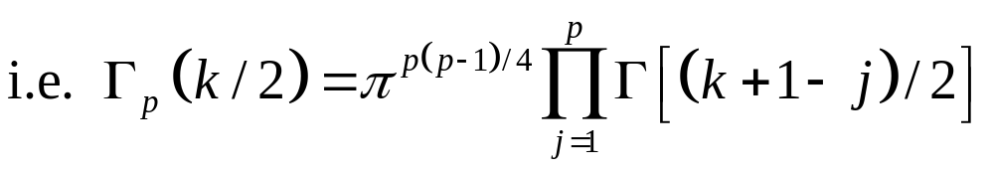
The density ot the p-variate Wishart distribution
Suppose
Then the joint density of U is:
where Γ_{p}(·) is the multivariate gamma function.
It can be easily checked that when p = 1 and Σ = 1 then the Wishart distribution becomes the χ² distribution with k degrees of freedom.

Slide 25
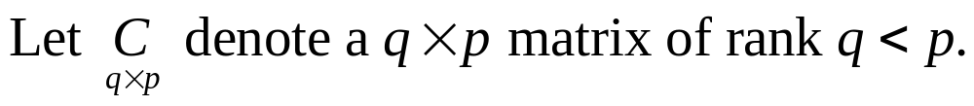
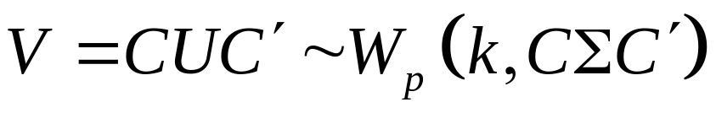
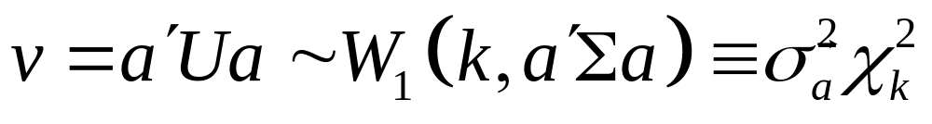




Theorem
Suppose
then
Corollary 1:
Corollary 2:
Proof

Slide 26





Theorem
Suppose
are independent, then
Theorem
Suppose
are independent and
then

Slide 27




Theorem
Let
be a sample from
then
Theorem
Let
be a sample from
then

Slide 28




Theorem
Proof
etc

Slide 29




Theorem
Let
be a sample from
then
is independent of
Proof
be orthogonal
Then

Slide 30


Note H* is also orthogonal

Slide 31



Properties of Kronecker-product

Slide 32



Slide 33




Slide 34



This the distribution of
is np-variate normal with mean vector

Slide 35






Thus the joint distribution of
is np-variate normal with mean vector

Slide 36



Thus the joint distribution of
is np-variate normal with mean vector

